Slide 1
KOKO-NET
Backend and Frontend Tech

Slide 2
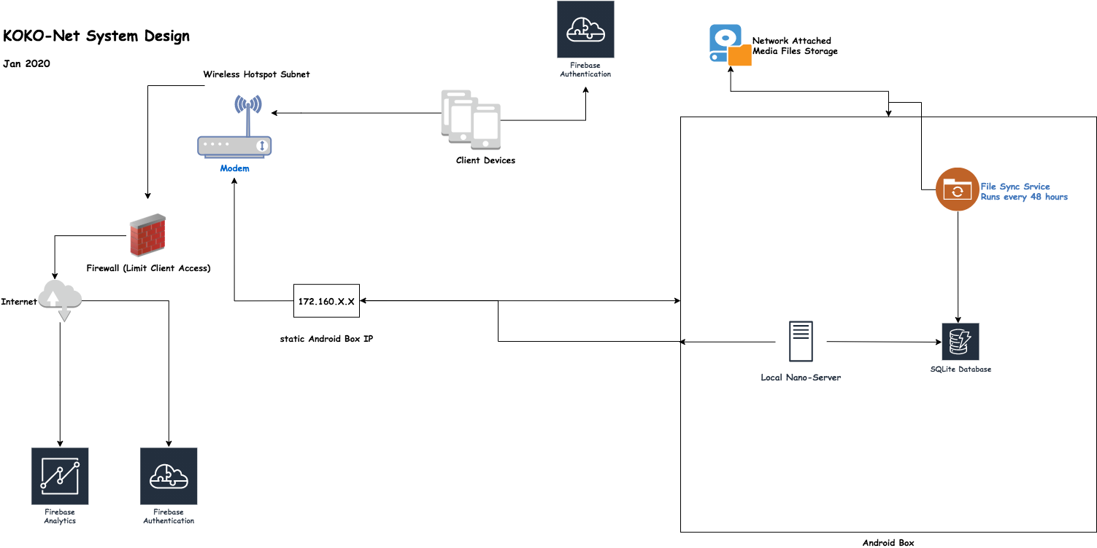
System Design - Overview

Slide 3
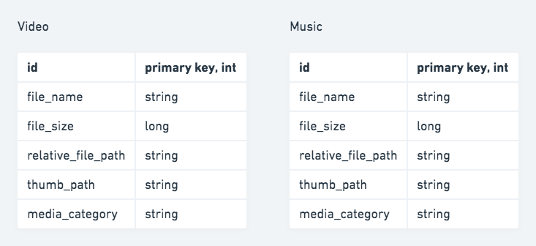
2. Database Schema

Slide 4
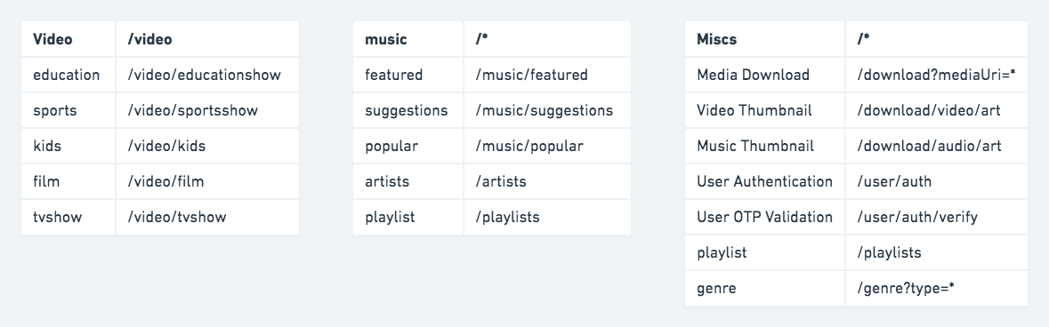
3. Functional Requirements - API Endpoints

Slide 5
4. Non-Functional Requirements - Performance
External router in place of Android box is used for the wifi hotspot, in order to support more connected users (at least 6 concurrent). From tests this has shown better service availability and consistency.
Server design is multi-threaded hence able to support multiple requests from multiple users, and scales upto a limit of thread pool size.
Network Attached Storage (NAS) is of 1TB, which is sufficient to support the target amount of content.

Slide 6
5. Backend - content serving platform
A local server runs in the Android Box - responsible for syncing files with NAS and serving consumer clients connected to KOKONet.
We use NAS for the video/music storage
Syncing maps data in the database with embedded metadata extracted from the Network Attached Storage (NAS) files
Firewall prevents internet access for connected clients who join the Hotspot subnet.
A static ip address is exposed for the local server - static IP for the Android Box via LAN. With a dedicated port, specified in router settings, we may not need this.

Slide 7
6. Report Generation - Analytics
Key business requirement is to gather some metrics such as user acquisition, popular content, hours spent consuming content via app
Firebase Analytics is used for gathering and reporting service usage statistics

Slide 8
7. Frontend -
This required custom Android app, since most of our users have Android phones
Useful Links:
KOKO-Net Hardware Installation on KP Guide
KOKO-Net Configuration on Android Box & Modem
KOKO-Net Client Code Repository
KOKO-Net Server Code Repository

